Slide 1
A presentation on myself
Prateeti roy
Id 18051049
Reg 8056

Slide 2
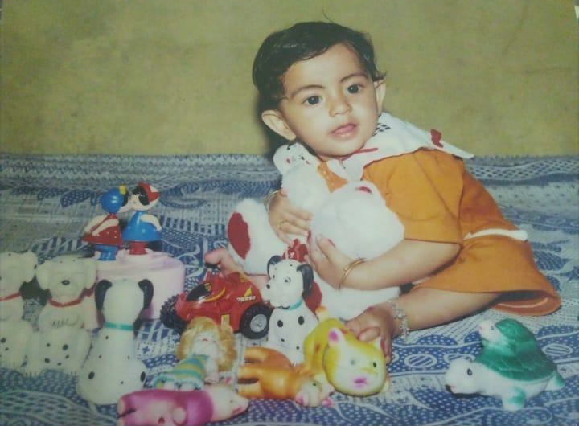
Call me roy!
Hi, my name is Prateeti Roy, 23 years of age, and I’m a student of Doctor of Veterinary Medicine at Patuakhali Science and Technology University.

Slide 3
Meet My family
I come form a middle class family of four.
My family includes my parents, my younger sister and myself
My father lives away for his business and the rest of us live in a beautiful city called Sylhet

Slide 4
My hobbies
Travelling
Watching movies
Playing the guitar
Photography

Slide 5
A few of my favorite things
Favorite drink: Tea
Favorite movie genre: Sci-fi
Favorite subject: Public Health
Favorite sport: Football
Favorite colour: Blue and Yellow

Slide 6
My goals for this year
To perform better in exams
To write a research paper
To grow as a person
To be more kind

Slide 7
Thank you, everyone.
-Prateeti Roy

